Slide 1
ỦY BAN NHÂN DÂN QUẬN 3 PHÒNG GIÁO DỤC VÀ ĐÀO TẠO

Slide 2
ỦY BAN NHÂN DÂN QUẬN 3 TRƯỜNG TIỂU HỌC NGUYỄN THI
MÔN TIẾNG ANH LỚP 4
Giáo viên thực hiện: Lê Toàn Thắng
Năm học: 2021 - 2022

Slide 3
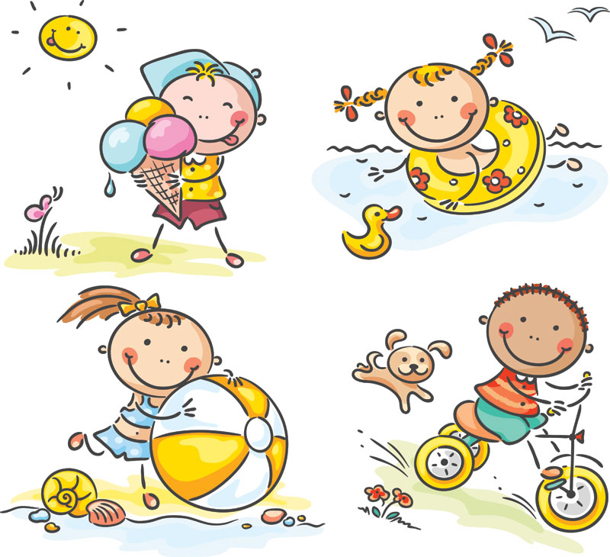
GRADE 4
UNIT TWO
My weekend
Lesson 5

Slide 7
Listen and point

Slide 8
play the guitar

Slide 9
shop

Slide 10
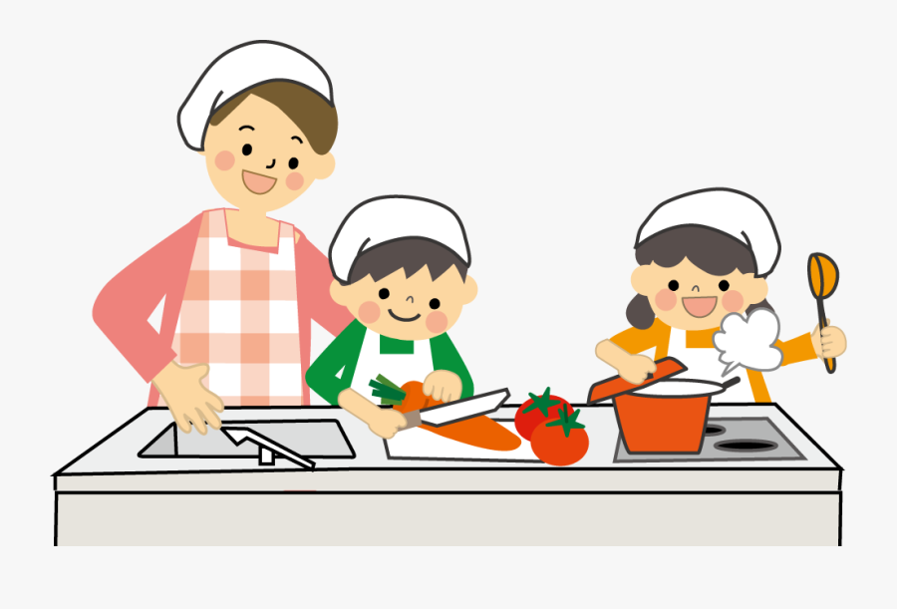
cook

Slide 11
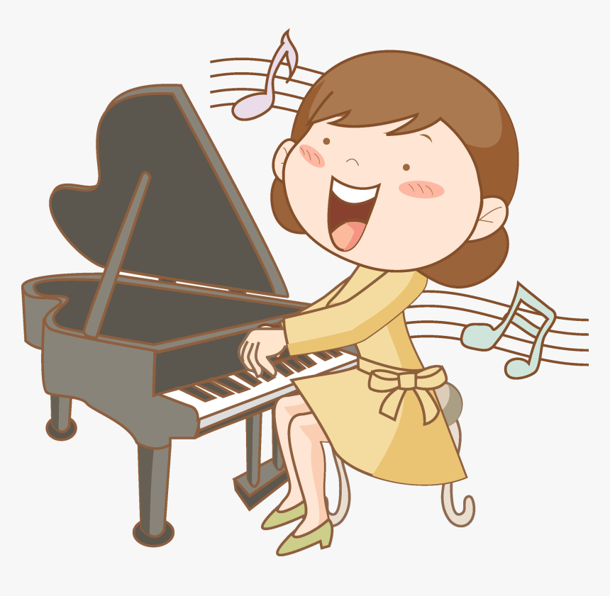
play the piano

Slide 12
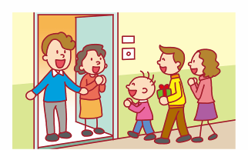
visit family

Slide 13
LISTEN and REPEAT.
OK.

Slide 14
play the guitar

Slide 15
shop

Slide 16
cook

Slide 17
play the piano

Slide 18
visit family

Slide 19
Listen and point

Slide 21
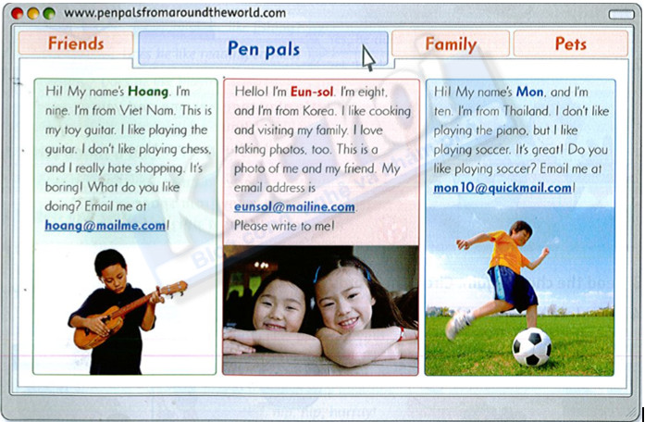
Task: read again

Slide 22
Answer these questions
Does Hoang like playing the guitar? _yes_ 3. Does Eun-sol like cooking? ____ 5. Does Mon like playing soccer? ____ | 2. Does Hoang like shopping? ___ 4. Does Eun-sol like taking photos? ___ 6. Does Mon like playing the piano? ___
No
Yes
Yes
Yes
No

Slide 23
GAME TIME.
Yeah.

Slide 24
1/ Hoang likes playing the guitar.
2/ Eun-sol is from Thailand.
3/ Hoang thinks shopping is boring.
4/ Mon likes playing the piano.

Slide 25
5/ Hoang is nine years old.
6/ Mon loves badminton because it’s great.
7/ Eun-sol likes cooking and visiting her family.
8/ Mon is from Brazil.

Slide 26
Task: choose a friend below and reply his/her email

Slide 27
Workbook time!!!

Slide 30
ỦY BAN NHÂN DÂN QUẬN 3 TRƯỜNG TIỂU HỌC NGUYỄN THI
XIN CHÂN THÀNH CÁM ƠN
Giáo viên thực hiện: Lê Toàn Thắng
Trang website của trường Nguyễn Thi https://thnguyenthiq3.hcm.edu.vn

